Slide 1

Constitutional Officers and the County Budget Process: Keys to Success
Thomas M. Couch
County Manager
Bulloch County, Georgia
First in Safety and Service

Slide 2
Topic Summary
Understanding Roles
A Manager’s Experience
The General Appropriations Budget Process
Importance of Financial Policies
Preventing and Resolving Conflict
Conclusions

Slide 3

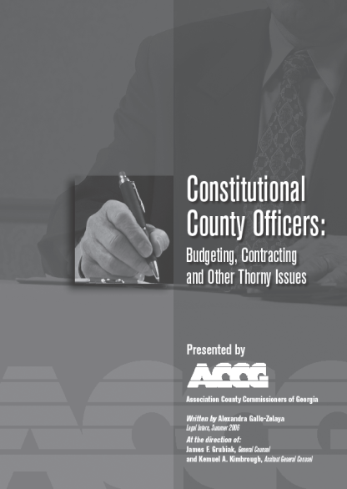
Understanding Roles
Commissioners Handbook: Chapters 3 (Limits of Power), 4, 5 (Roles), 7 (Ethics, Abuse of Office) and 9 (Contracting, Purchasing, Sale of Property, 18-22 (Finance), 27 (Conflict Resolution
County Constitutional Officers: ALL OF IT!
Relate what you read to actual experience.
MUST READS!!!!!
CARRY THESE AND REFER TO THEM LIKE YOUR BIBLE!!

Slide 4
Understanding Roles
Conventional Wisdom: There are a lot of powers available to the governing authority over constitutional officer.
Fact: Many constitutional officers do not agree.

Slide 5
Understanding Roles
Fact: There are four constitutional county officers (Sheriff, Clerk of Courts, Tax Commissioner, Probate Judge), and sort of a fifth (Magistrate Court).
Conventional Wisdom: There are other county elected and “appointed” officials who think and act like they’re constitutional officers (State Court and Solicitor, Coroner, Tax Assessor, etc.)

Slide 6
A Manager’s Experience…
“Under the Shade Tree” story….
“Caught in the Act!” story….
“Just what do they do?” story….
“My numbers v. your numbers” story….

Slide 7
Budget Process in Bulloch County: “The Package”
PART ONE: BUDGET PROCESS
Critical Issues and Ranked Priorities
General Preparation Guidelines
Budget Calendar
Position Control
Questions and Contacts

Slide 8
Budget Process in Bulloch County: “The Package”
PART TWO: BUDGET FORMS
General
Availability and Submission
Forms Description
DBS-1: Abstract of Program or Department Services
DBS-2: Activity Measures and Staffing Detail
SR-1: Priorities Summary
SR-2: Additional Positions
SR 3: Travel and Training
SR-4: General Expenses
SR-5: Minor Capital Outlays
SR-6: Major Capital Outlays
SR-7: Final Request
REF-1: Position Allocation Charts
REF-2: Pay Grade
REF-3: Job Titles
FORMS FLOW CHART
GLOSSARY

Slide 9
Budget Process in Bulloch County: “The Stages”
Baseline Budget*
Supplemental Requests *
Interviews
Final Recommendations
Tentative Adoption
Final Adoption

Slide 10
Financial Policies
A long row to hoe!
Budgeting, Debt and Treasury Management, Capital Outlays, Accounting and Auditing, Revenues, Grants.
The UGA LGF program at Vinson has all the basics for a good start!
Keep everybody involved along the way as you implement them.

Slide 11
Preventing and Resolving Conflicts (or, the importance of getting “buy-in”)
Resist power struggles.
Do unto others……
Go the extra mile to meet frequently (have county-wide department head meetings at least twice a year - nobody ever died from a good fish-fry or pig-pickin’).
The up-side and down-side of policies and ordinances.

Slide 12
Conclusions
Am I not my brother’s keeper!
I am blessed!
“The name on the front of my jersey is more important than the one on the back of my jersey!
- Joe Paterno,
Penn State Head Football Coach

Slide 13
Contact
If I can offer you any information or documents……
Thomas Couch
115 North Main Street
Statesboro Georgia 30458 First in Safety and Service
tmcouch@bullochcounty.net
912.764.6245 Phone
912.764.8643 Fax

